Slide 1
Modern Database
Dr. Achmad Solichin, S.Kom., M.T.I.
Magister Manajemen | Universitas Budi Luhur
Note: The content of this short slide is adopted from https://dzone.com/articles/the-types-of-modern-databases and another resources

Slide 2
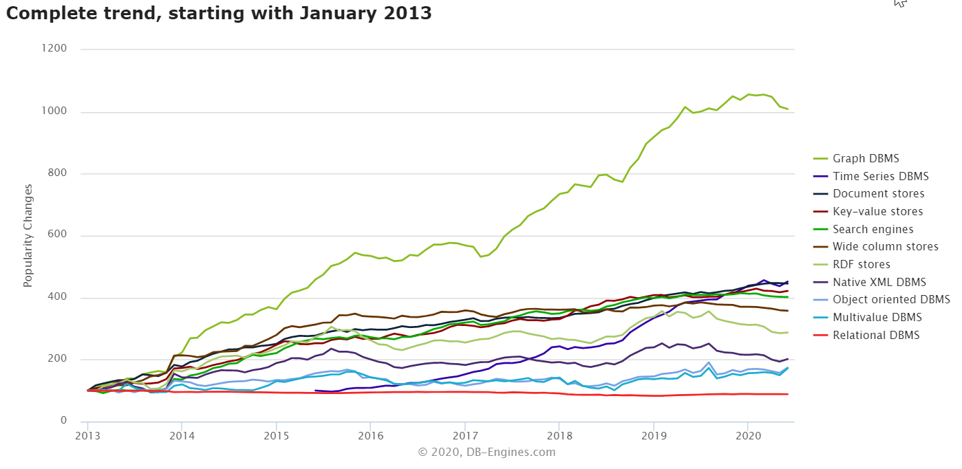
Database model trend

Slide 3
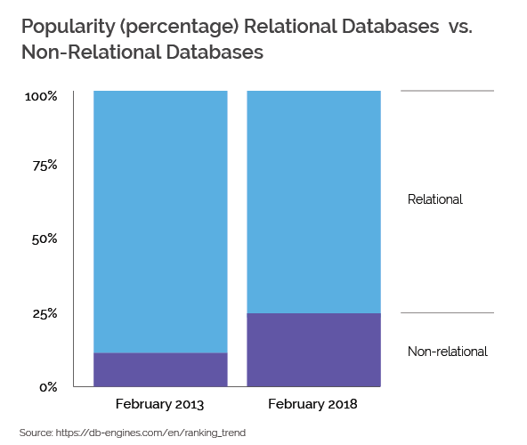
Relational vs Non-Relational DB

Slide 4
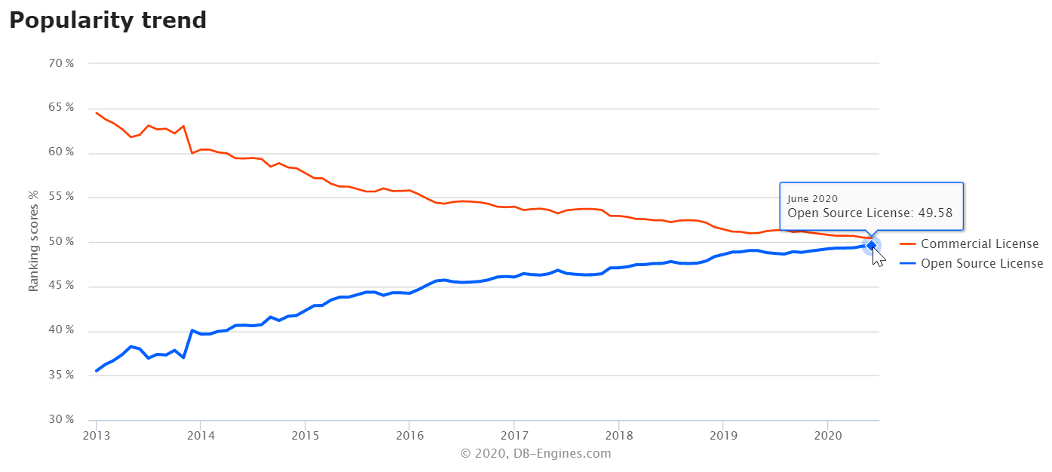
Commercial vs Opensource

Slide 5
SQL/RDBMS/Relational Databases
Advantages:
Relational databases are well-documented and mature technologies, and RDBMSs are sold and maintained by a number of established corporations.
SQL standards are well-defined and commonly accepted.
A large pool of qualified developers have experience with SQL and RDBMS.
All RDBMS are ACID-compliant, meaning they satisfy the requirements of Atomicity, Consistency, Isolation, and Durability.

Slide 6
SQL/RDBMS/Relational Databases
Disadvantages:
RDBMSs don't work well — or at all — with unstructured or semi-structured data due to schema and type constraints. This makes them ill-suited for large analytics or IoT event loads.
The tables in your relational database will not necessarily map one-to-one with an object or class representing the same data.
When migrating one RDBMS to another, schemas and types must generally be identical between source and destination tables for migration to work (schema constraint). For many of the same reasons, extremely complex datasets or those containing variable-length records are generally difficult to handle with an RDBMS schema.

Slide 7





SQL/RDBMS/Relational Databases

Slide 8
NoSQL/Non-Relational Databases
NoSQL databases emerged as a popular alternative to relational databases as web applications became increasingly complex. NoSQL/non-relational databases can take a variety of forms.
However, the critical difference between NoSQL and relational databases is that RDBMS schemas rigidly define how all data inserted into the database must be typed and composed, whereas NoSQL databases can be schema-agnostic, allowing unstructured and semi-structured data to be stored and manipulated.

Slide 9

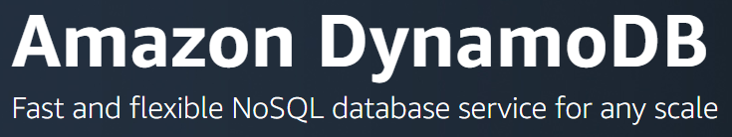
Types of Non-Relational DB
Key-value stores, such as Redis and Amazon DynamoDB, are extremely simple database management systems that store only key-value pairs and provide basic functionality for retrieving the value associated with a known key. The simplicity of key-value stores makes these database management systems particularly well-suited to embedded databases, where the stored data is not particularly complex and speed is of paramount importance.

Slide 10


Types of Non-Relational DB
Wide column stores, such as Cassandra, Scylla, and HBase, are schema-agnostic systems that enable users to store data in column families or tables, a single row of which can be thought of as a record — a multi-dimensional key-value store. These solutions are designed with the goal of scaling well enough to manage petabytes of data across as many as thousands of commodity servers in a massive, distributed system. Although technically schema-free, wide column stores like Scylla and Cassandra use an SQL variant called CQL for data definition and manipulation, making them straightforward to those already familiar with RDBMS.

Slide 11


Types of Non-Relational DB
Document stores, including MongoDB and Couchbase, are schema-free systems that store data in the form of JSON documents. Document stores are similar to key-value or wide column stores, but the document name is the key and the contents of the document, whatever they are, are the value. In a document store, individual records do not require a uniform structure, can contain many different value types, and can be nested. This flexibility makes them particularly well-suited to manage semi-structured data across distributed systems..

Slide 12


Types of Non-Relational DB
Graph databases, such as Neo4J and Datastax Enterprise Graph, represent data as a network of related nodes or objects in order to facilitate data visualizations and graph analytics. A node or object in a graph database contains free-form data that is connected by relationships and grouped according to labels. Graph-oriented database management systems (DBMS) software is designed with an emphasis on illustrating connections between data points. As a result, graph databases are typically used when analysis of the relationships between heterogeneous data points is the end goal of the system, such as in fraud prevention, advanced enterprise operations, or Facebook's original friend's graph.

Slide 13




Types of Non-Relational DB
Search engines, such as Elasticsearch, Splunk, and Solr, store data using schema-free JSON documents. They are similar to document stores, but with a greater emphasis on making your unstructured or semi-structured data easily accessible via text-based searches with strings of varying complexity.
Time-Series databases: database optimized for storing and manipulating time series data (where timestamps are best treated as discrete quantities rather than continuous mathematical dimensions). Example: InfluxDB

Slide 14
NoSQL / Non-Relational DB
Advantages:
Schema-free data models are more flexible and easier to administer.
NoSQL databases are generally more horizontally scalable and fault-tolerant.
Data can easily be distributed across different nodes. To improve availability and/or partition tolerance, you can choose that data on some nodes be eventually consistent.

Slide 15
NoSQL / Non-Relational DB
Disadvantages:
NoSQL databases are generally less widely adopted and mature than RDBMS solutions, so specific expertise is often required.
There is a range of formats and constraints specific to each database type.

Slide 16
Which Database Is Right For You?
If ACID (Atomicity, Durability, Consistency, and Durability) compliance is your first priority, consider using RDBMS.
If you have a massively distributed system and can settle for eventual consistency on some nodes/partitions, you might consider a wide column store such as Cassandra or Scylla.
If your input data is particularly heterogeneous and difficult to encapsulate according to a normalization schema, consider using a NoSQL DBMS.
If your goal is to scale vertically, consider an RDBMS; conversely, if you want to scale horizontally, a NoSQL DBMS may be preferable.

Slide 17
Common applications of NoSQL DB
Social applications: usually a social application, can scale from a zero to millions of users in few weeks and to better manage this growth, one needs a DB that can manage massive number of users and data, but also that can scale horizontally easily.
Online advertisement/BI: For ads to reach a wide number of potential users, it is important to be able to target specific users. NoSQL database help one develop and deploy the application that should manipulate billions of data (events, content and users using flexible data schema)
Archiving Data: if one wants to archive data and keep them available to the user, NoSQL databases can help you. First of all, one can store and access a huge volume of data when stored in NoSQL. When using document oriented NoSQL Engine such as Couchbase, MongoDB, one can store any type of data (flexible schema/schema-less) allowing you to archive anything.

Slide 18
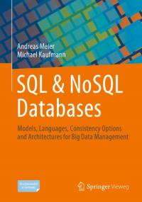
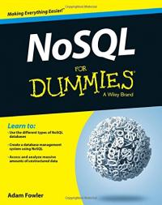
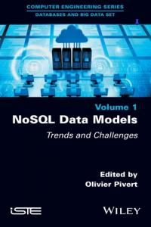

Further Readings

Slide 19
References
https://dzone.com/articles/the-types-of-modern-databases
https://www.analyticsindiamag.com/nosql-vs-sql-database-type-better-big-data-applications/
https://dzone.com/articles/nosql-vs-sql-differences-explained?fromrel=true

Slide 20
Assignment
Carilah informasi di berbagai sumber mengenai salah satu dari jenis database Non-Relational, buatlah tulisan/laporan yang minimal mencakup:
Penjelasan fitur-fitur dari DB
Kelebihan dan kekurangan dari DB
Instansi / situs / perusahaan yang menggunakan DB tersebut baik di dalam negeri / luar negeri.
Dikumpulkan melalui elearning.

Slide 21
Thank you
Achmad Solichin | Universitas Budi Luhur

